Slide 1

Please delete this sheet before submitting

Slide 2


Using The WORK BREAKDOWN STRUCTURE Sheet
Should you face any difficulty in completing this phase, please refer to 'Project Planning' Workshop, https://cloudcounselage.graphy.com/sessions/Project-Planning-64af88dcb308530823e2c19f
Before submitting the file, please rename the file as ‘IAC IP23 – WBS – Your Domain Name – Your full name’ and submit as PDF
The Work Breakdown Structure (WBS) provided is just a guideline, you are allowed to modify the same based on your problem statement
Given the timeline and deliverables the WBS is based on Waterfall Methodology
Add tasks wherever required based on your problem statement
Follow the below colours for Project hierarchy
Please delete this sheet before submitting
Project Goal
Phases
Stages
Activities/
Deliverables
Tasks

Slide 3
WORK BREAKDOWN STRUCTURE – IP23 Live Project Deliverables– ‘Software Development’
Create an
‘APPLICATION’
as per Industry Ways of Working
INITIATION
Project Charter
SRS Document
PLANNING
WBS
Project Schedule
RAID Logs
EXECUTION & MONITORING
CLOSURE
Lessons Learnt, Project Report
Design
Develop
Test
Deploy
Design Specification
Code
Test Plan
Test Results
App Video, Installation Guide
<Task 1>
<Task 2>
<Task 3>
<Task 4>
Research
Analyse
Design

Slide 4

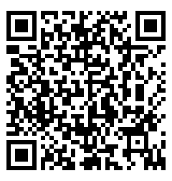
Our Contact
Please delete this sheet before submitting
Member@IndustryAcademiaCommunity.com
You may even raise queries in the Q&A section of your respective domain community on the IAC platform

